Slide 1



Eye Blink Pattern Controlled System
Using Wearable EEG Headband
Nilkanth K. Jadhav
Walchand College of
Engineering, Sangli Maharashtra, India
Bashirahamad F. Momin
Walchand College of
Engineering, Sangli Maharashtra, India

Slide 2
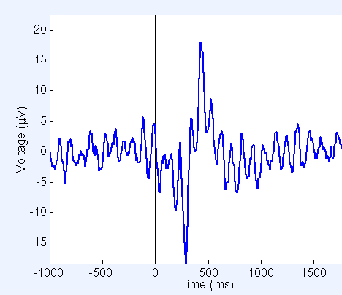
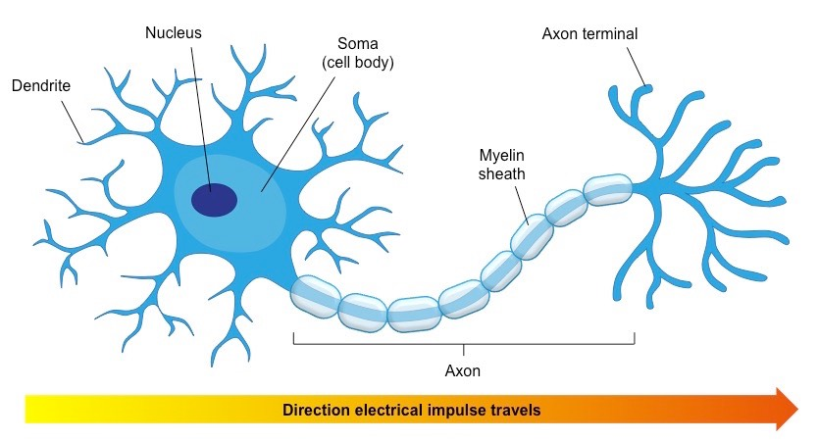
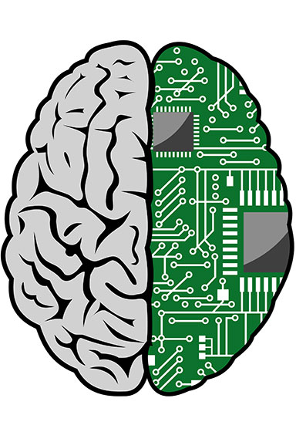
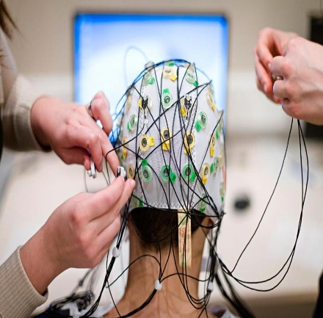
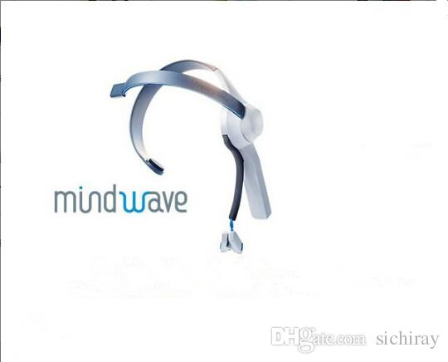
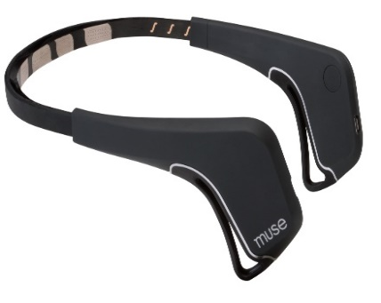
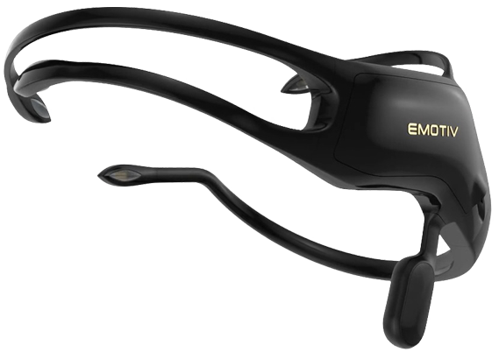
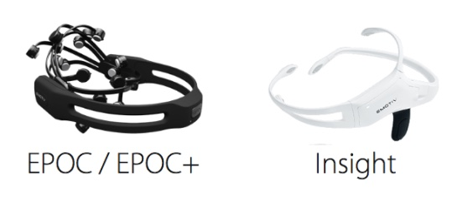
Introduction
Introduction
Neurons
Electroencephalography (EEG)
Wearable EEG Sensor
Brain–Computer Interfaces (BCI)
Brainwave Type | Frequency
Delta | < 4 Hz
Theta | 4 - 7 Hz
Alpha | 8 - 12 Hz
Beta | 12 - 36 Hz
Gamma | > 36Hz
Research Grade
EEG System

Slide 3
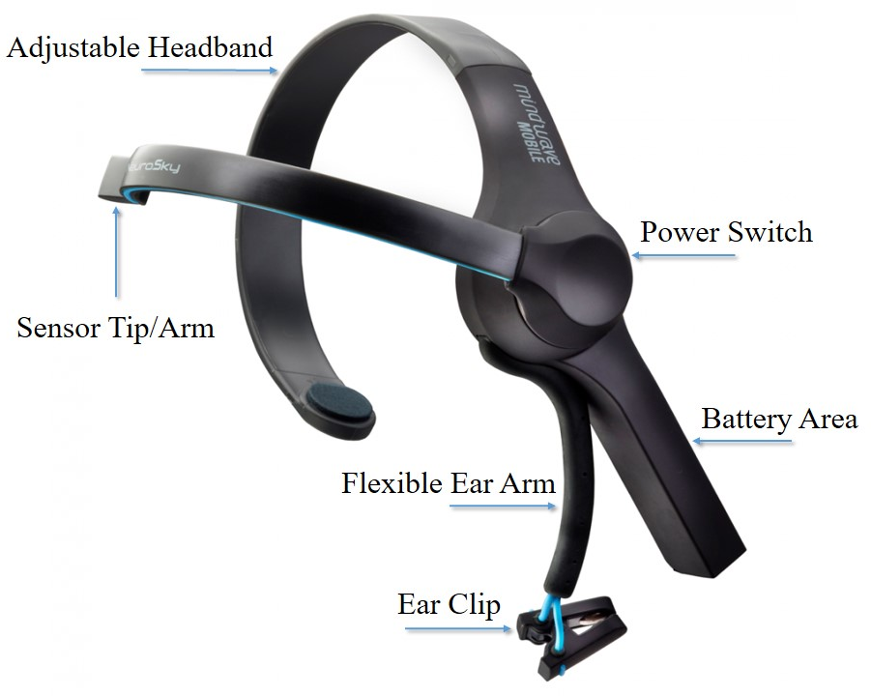
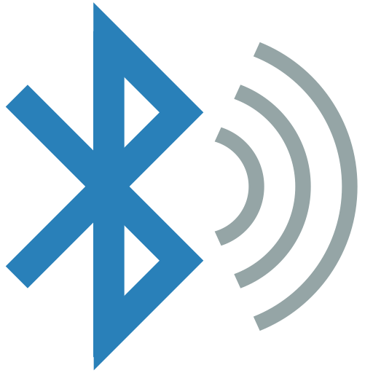
EEG Headband – Neurosky Mindwave
EEG Headband – Neurosky Mindwave
Features:
Easy to wear
Dry EEG Sensor
Bluetooth Connectivity
Operates on AAA Battery
Ear Clip to earthen static charge
EEG, Attention, Meditation, Eye-Blink

Slide 4
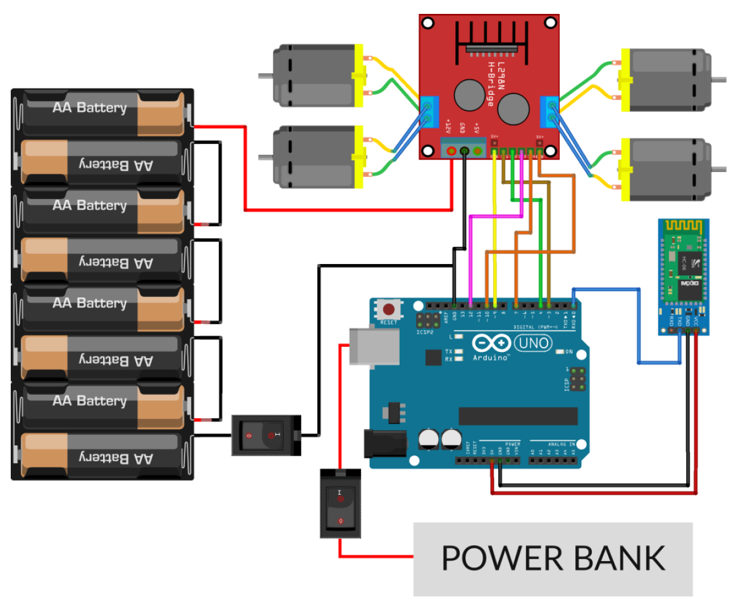
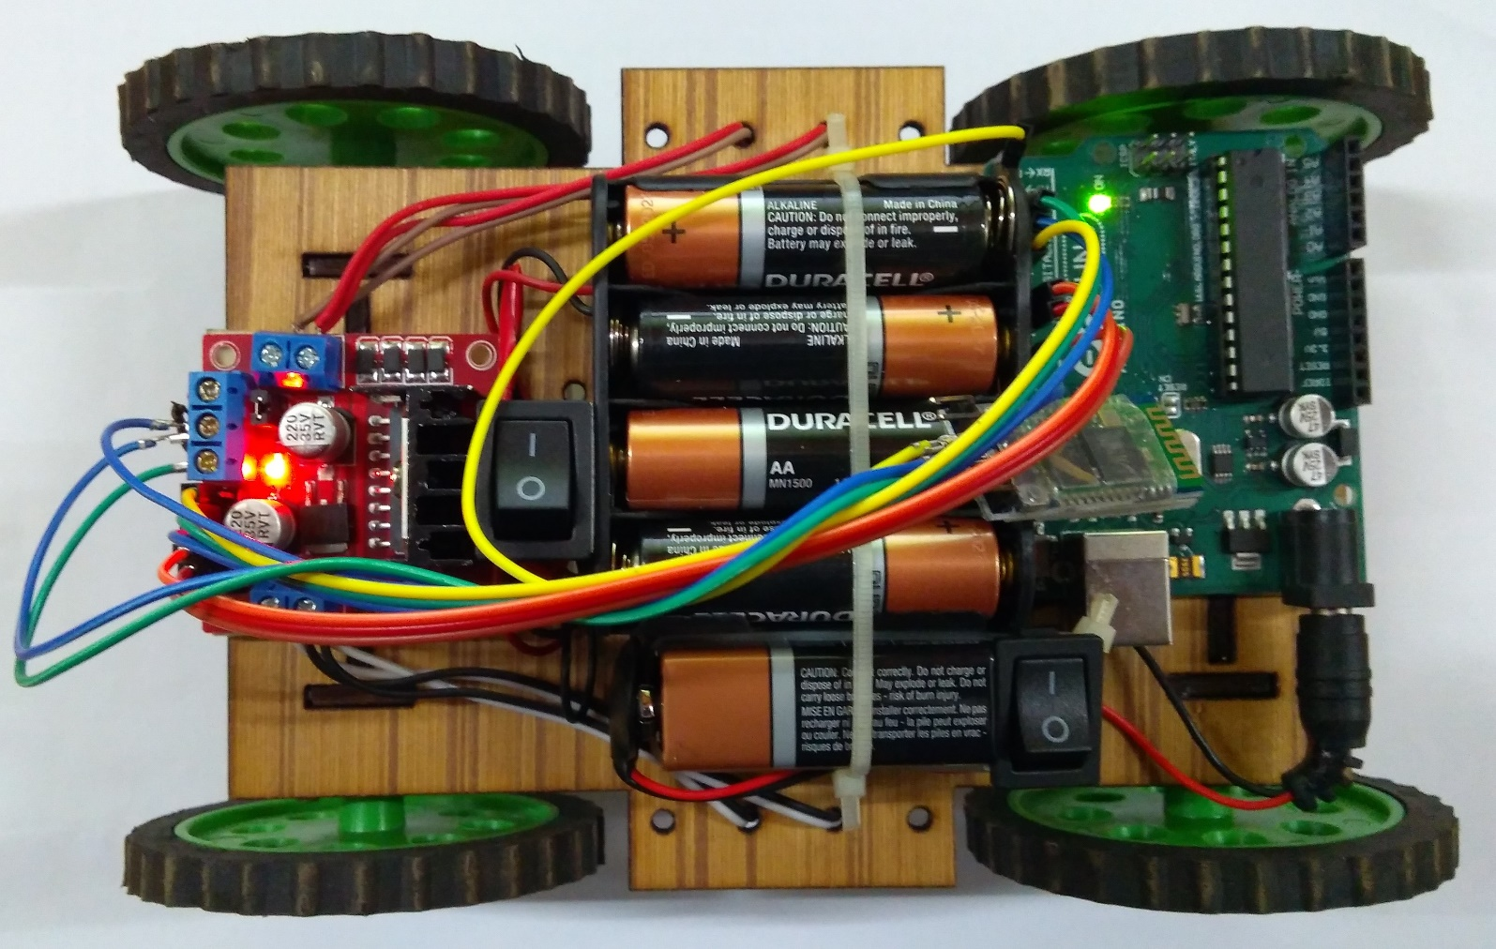
Software and Hardware Requirements
Software Requirements
Arduino IDE
Neurosky Mindwave EEG Headset Drivers
OpenViBE
Bluetooth Drivers
Android SDK
Hardware Requirements
Component | Count
Mindwave Mobile EEG Headband | 1
Arduino UNO | 1
Motor Driver L298N | 1
Bluetooth Module HC-05 | 1
DC Motors | 4
ON-OFF Buttons | 2
Toy Car Chassis | 1
1.5V AA Batteries | 8
9V Battery | 1
Jumper Wires | 30
Snap Connector for 9V battery | 1
8AA count Cell Socket | 1

Slide 5
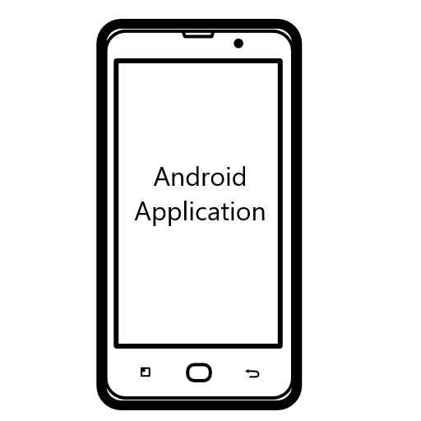
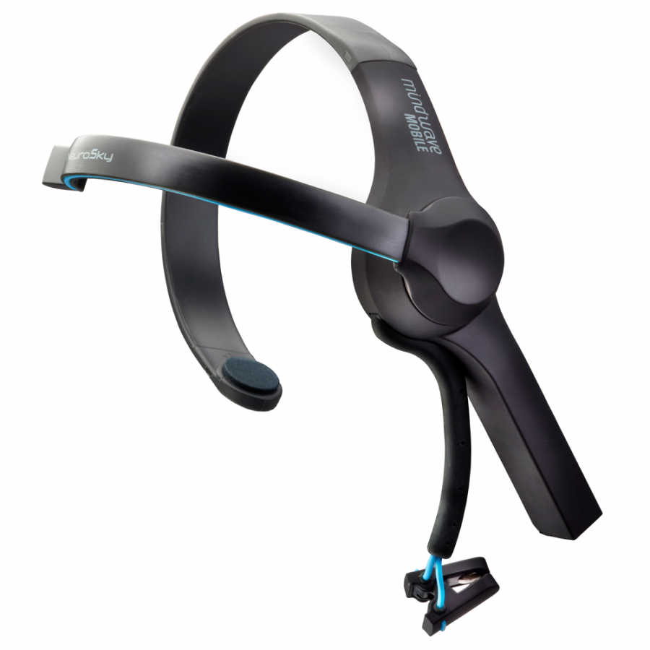
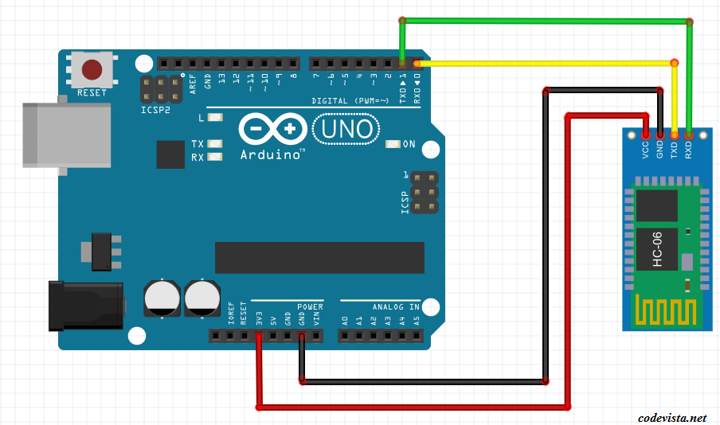

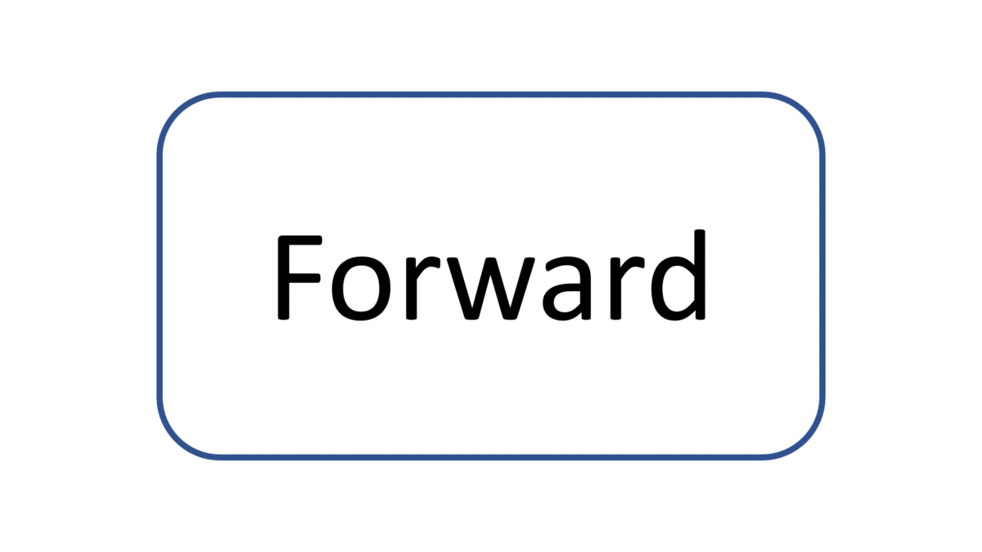
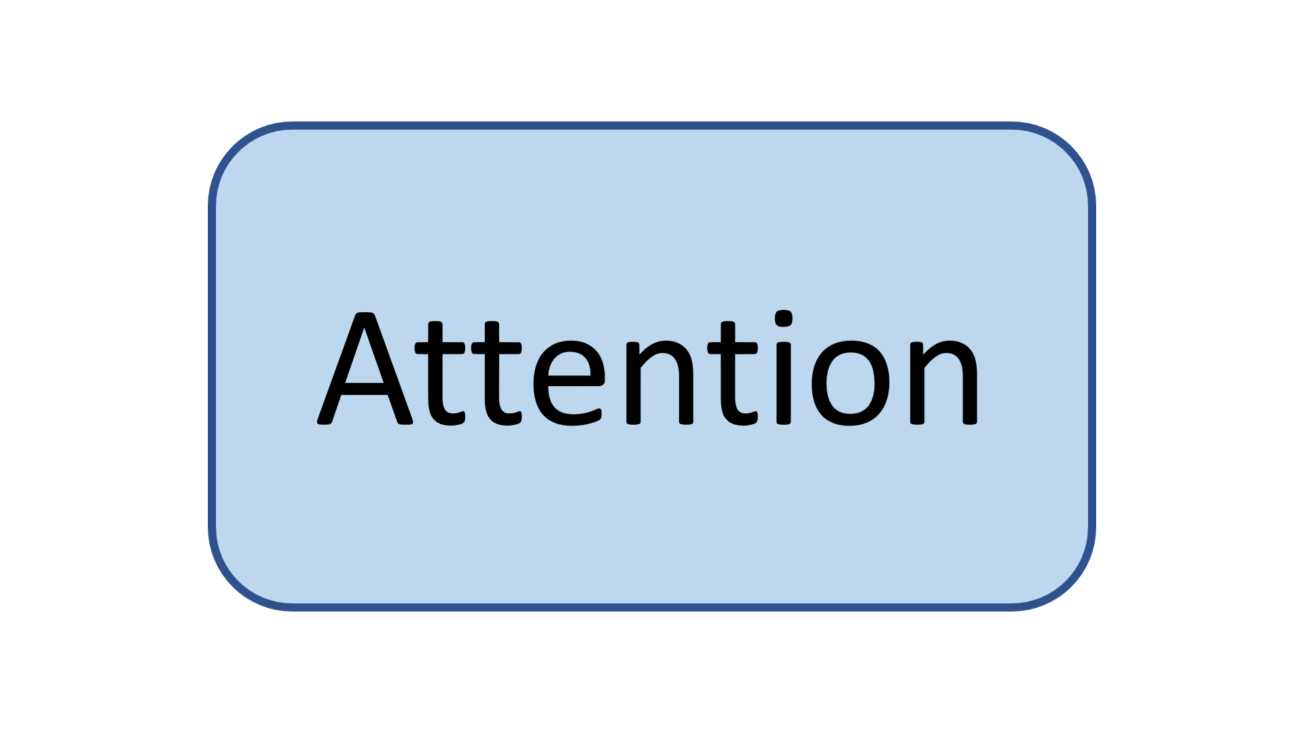
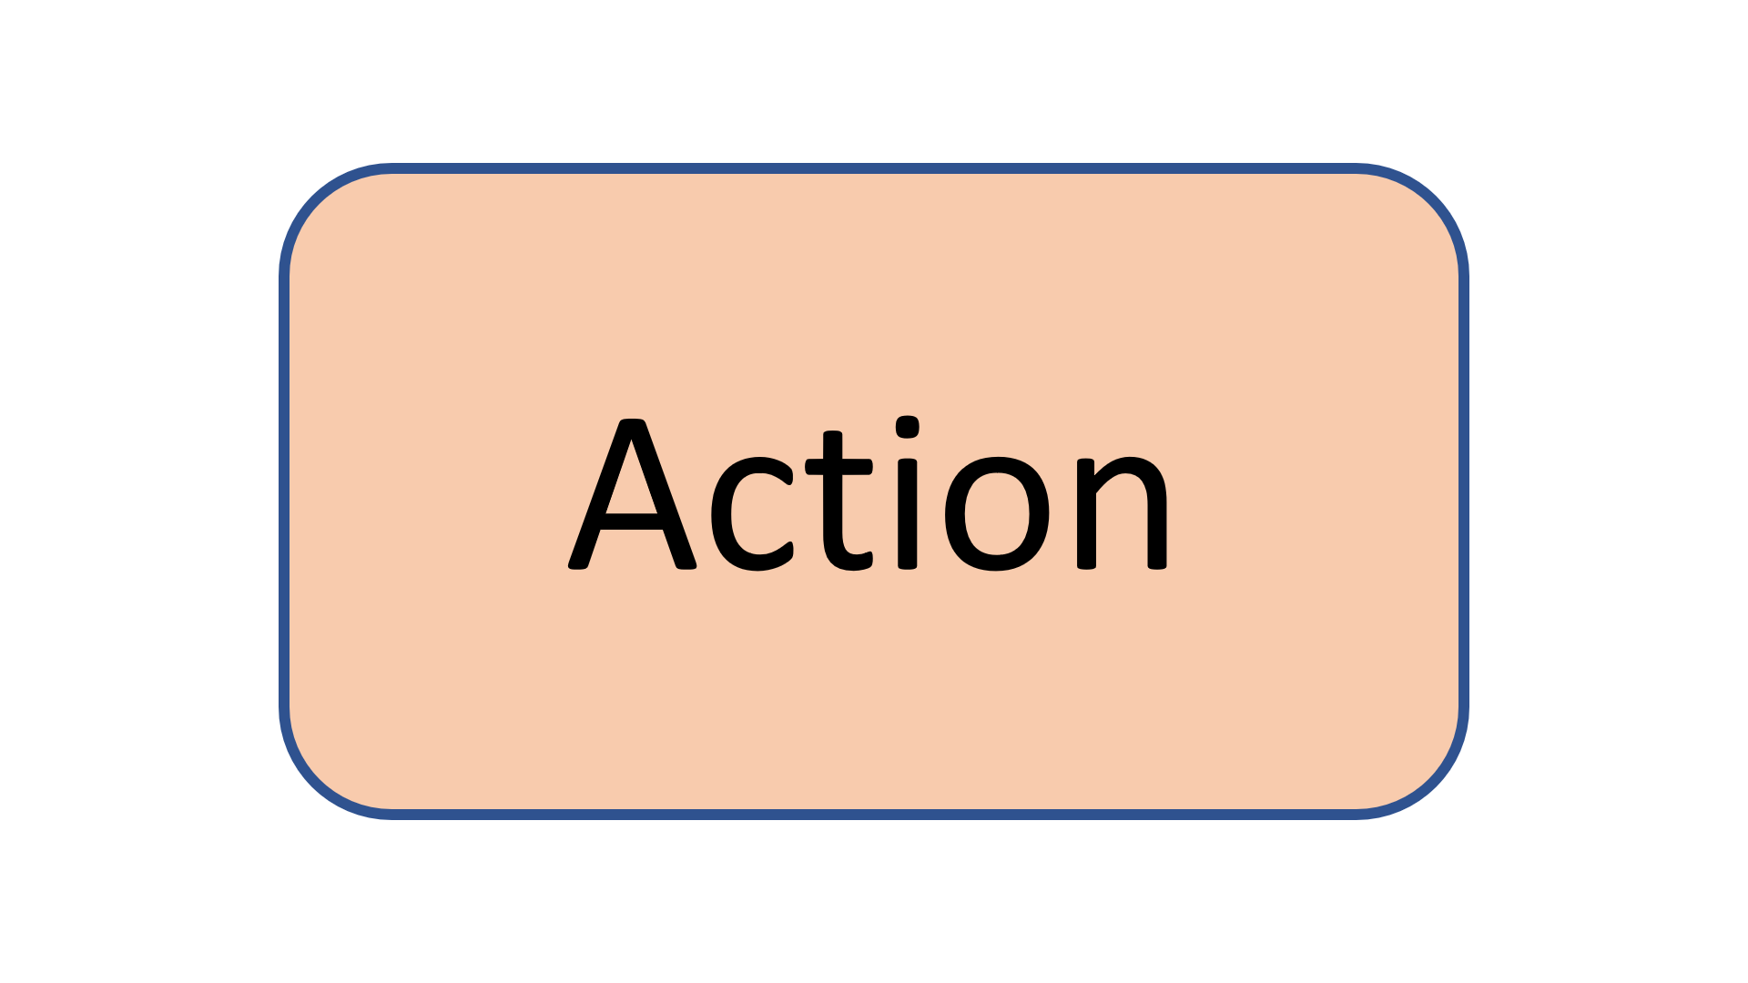

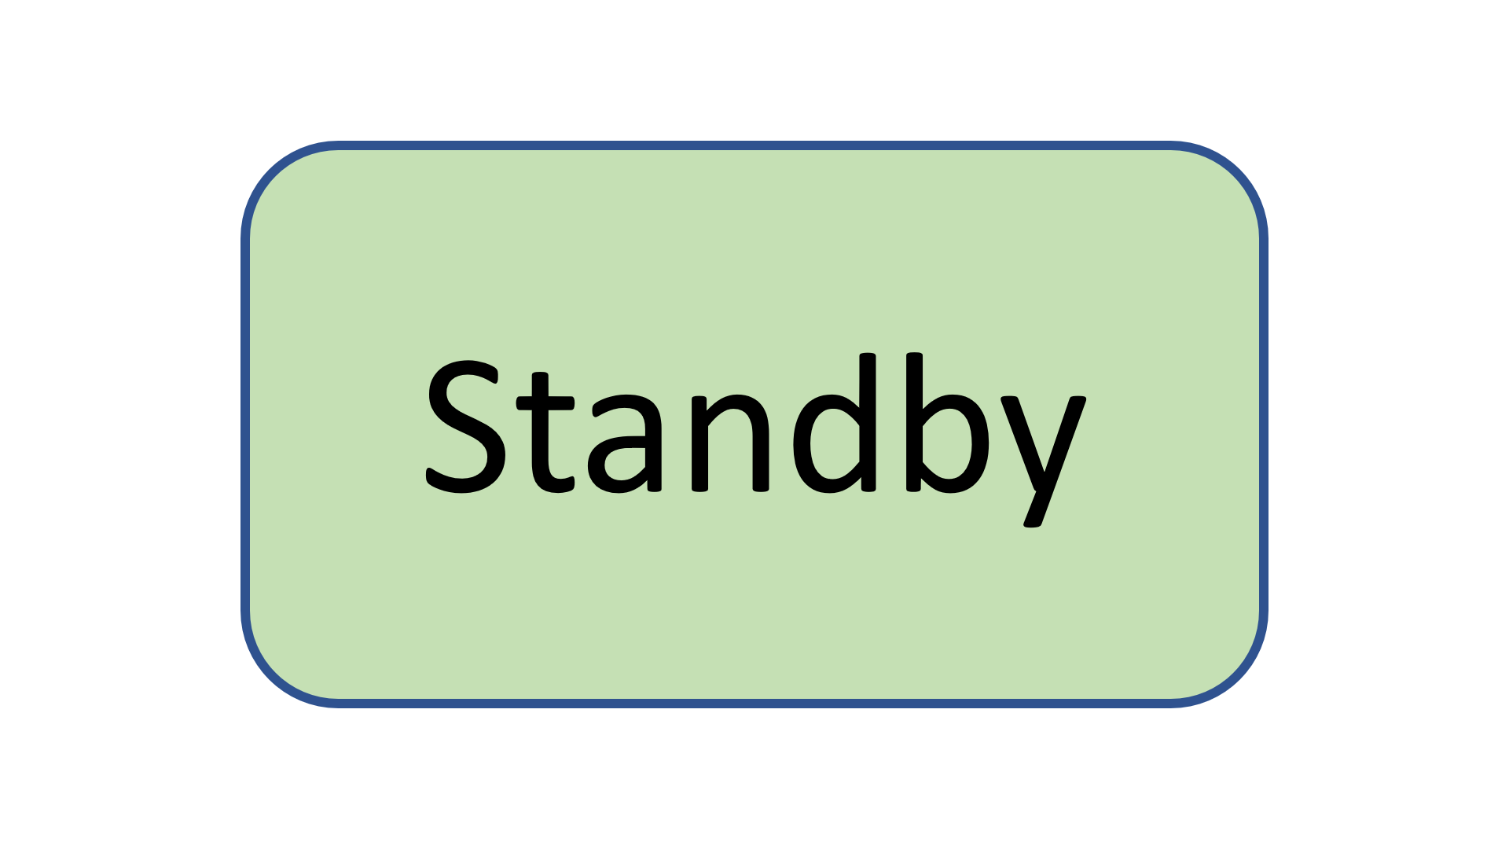
Eye Blink Pattern
and Attention Level
Command
(F,B,L,R)
Single
Blink
Double
Blink
Command Mode
Focus Mode
Running Mode
Lock Action Cycle Value
(Left)
Attention
> 50
Blink Strength
> Threshold
Double
Blink
Ready

Slide 6
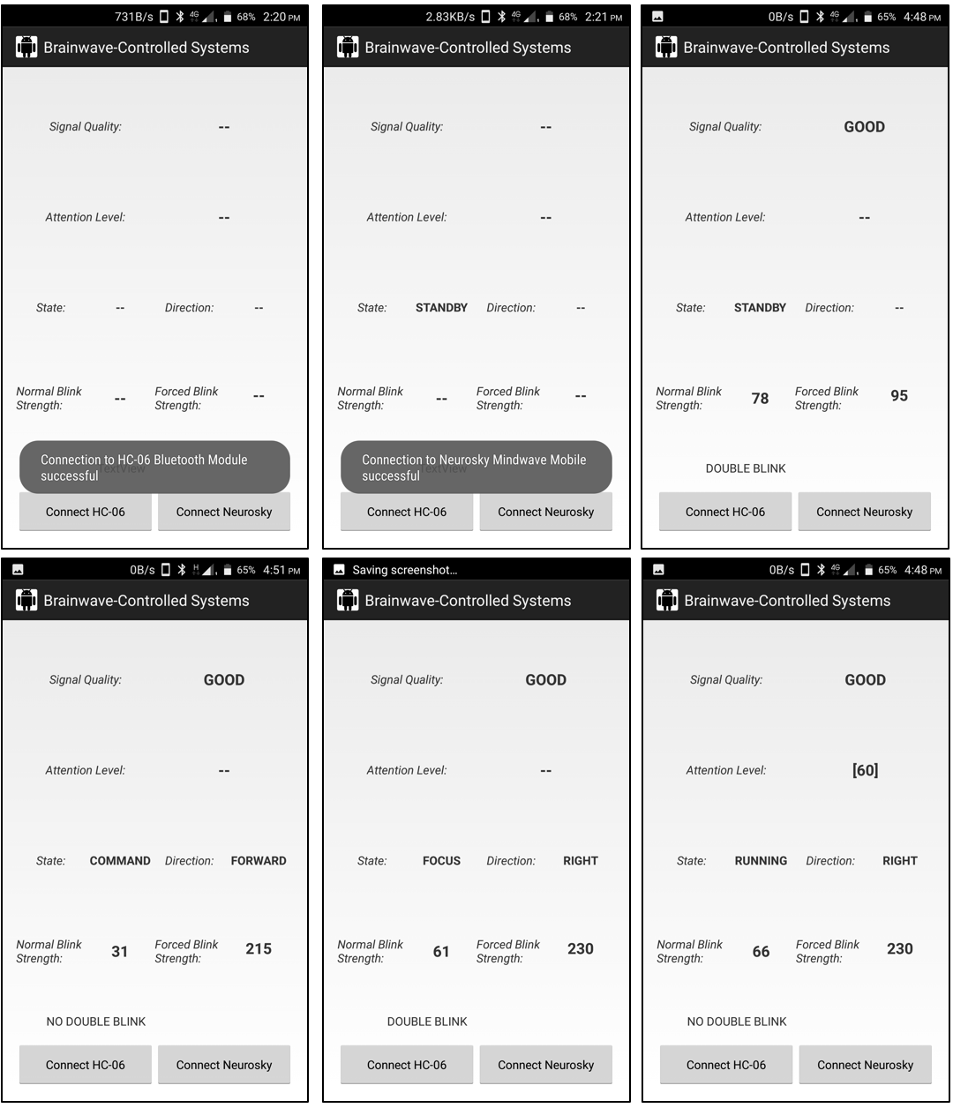

Slide 7
Thank You.
Nilkanth K. Jadhav
Email : mtech.nkjadhav@gmail.com
+91 8087082261

